Slide 1
Workflow foundation
The workflow way

Slide 2
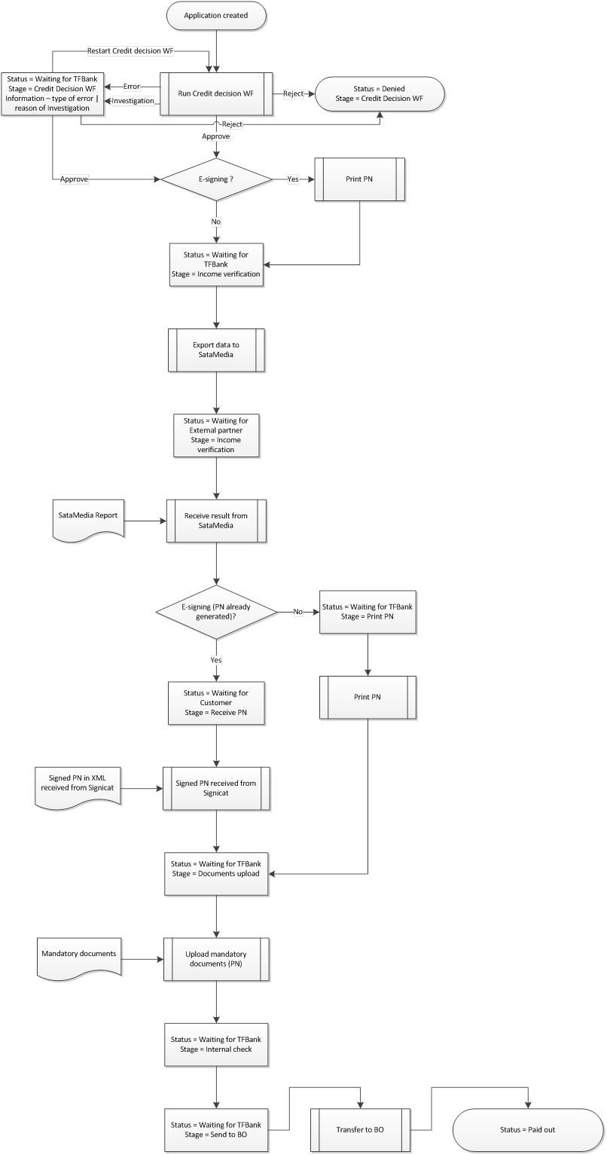
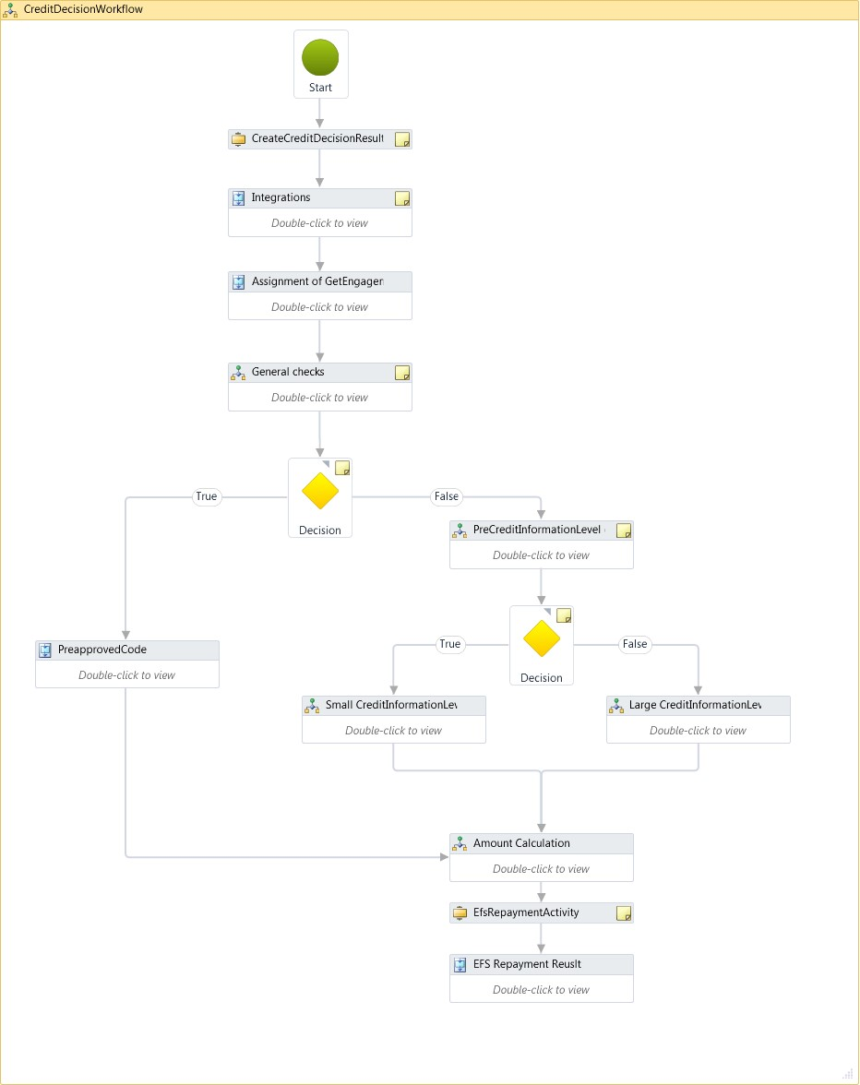

Slide 3
WF 4.5
.NET library
Standard part of .NET from version 3.0
Workflow creation and execution platform

Slide 4
Main principles
Workflows consisting of activities – encapsulating functionality into logical blocks
Activities treated as CLR objects
Activity execution, fault handling, data flow handled by workflow runtime

Slide 5
Why workflow?
Nothing I could not code in a different way, BUT:
Declarative way of programming
Easy visualization of business logic
Very close to the way we usually think about business processes
Visual tracking
Maintainability
Runtime changes
Users input

Slide 6
When to use
You have a process that changes frequently
You want a visual model of the process
You have a long-running process

Slide 7
Building a workflow
Create our building blocks
Custom activities / Out of the box activities
Program flow
Tie activities together
Data flow
Pass data between activities
Code / XAML based approach

Slide 8
Activities
Control flow
Implementing program flow
Messaging
WCF service communication
Primitives
Delay, WriteLine, InvokeMethod
Transactions
Error handling
TryCatch, Throw, Rethrow

Slide 9
Custom activities
Activity
CodeActivity
AsyncCodeActivity
NativeActivity

Slide 10
Program flow
Standard constructions
If, IfElse, Sequence, ForEach, ParellelForEach, While, DoWhile, Switch
FlowChart
FlowStep, FlowDecision, FlowChart, FlowSwitch
StateMachine
State, FinalState

Slide 11
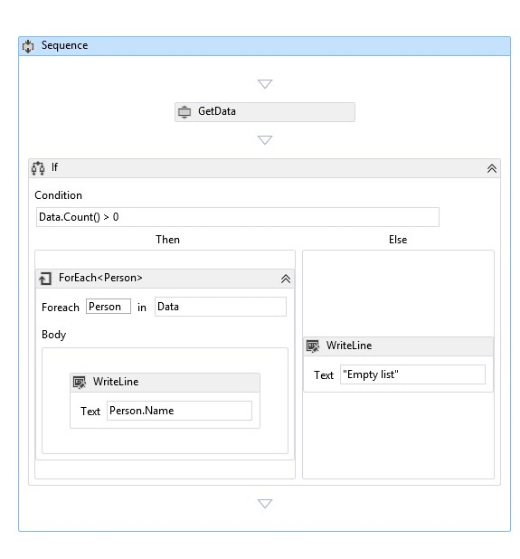
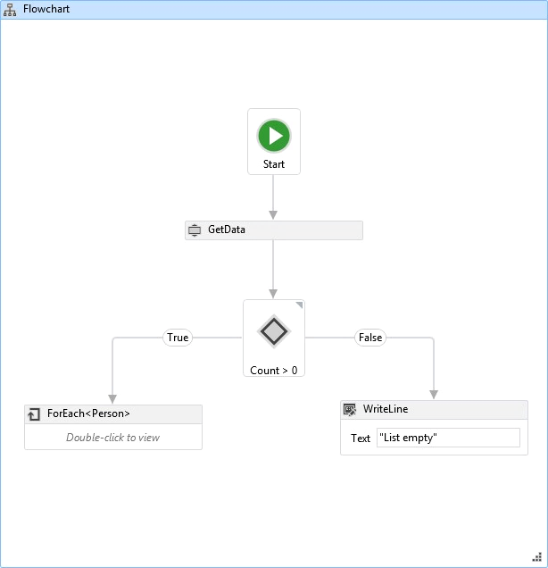
Different ways to implement program flow
Standard vs flowchart way

Slide 12
CODE SAMPLE program flow
Sequence s = new Sequence
{
Activities = {
new WriteLine {Text = "Hello"},
new Sequence {
Activities =
{
new WriteLine {Text = "Workflow"},
new WriteLine {Text = "World"}
}
}
}
};

Slide 13
Data flow
Variables
Storing data
Arguments
Passing data
Expressions
Acting on data

Slide 14
SAMPLE
Creating workflow

Slide 15
Executing worklow
WorkflowInvoker
Executes workflow on a calling thread
WorkflowApplication
Executes workflow on a new thread
WorkflowServiceHost
Executes workflow as a WCF service

Slide 16
CODE SAMPLE Workflow execution
WorkflowInvoker.Invoke(new Workflow());
var inputData = new Dictionary<string, object>() {
{"name", "Janko"},
{"surname", "Hrasko"}
};
WorkflowInvoker.Invoke(new Workflow(), inputData);

Slide 17
SAMPLE
Workflow execution
Workflow debugging

Slide 18
CODE SAMPLE Workflow loading
Activity mathWF;
using (Stream mathXaml = File.OpenRead("Math.xaml"))
{
mathWF = ActivityXamlServices.Load(mathXaml);
}

Slide 19
Activity designers
Possibility to create activity designer using WPF functionality and XAML and bind it with our activity
Example: Use combobox for input argument
AcitivityDesigner
WorkflowItemPresenter
WorkflowItemsPresenter
ExpressionTextBox

Slide 20
Extensions
Tracking
Tracking profiles (filtering) + tracking participants (workflow event handling)
Default ETW tracking participant + custom participants
Events: activity started, completed, faulted, custom etc…
Persistence
Storing workflow state in SQL database while idle
Rehosting designer
Possibility to use Visual studio designer and rehost it in a WPF application

Slide 21
SAMPLE
Rehosting designer
Workflow tracking

